Slide 1



SURVEY REPORT ON
SOCIAL NETWORK ANALYSIS APPLICATIONS
DSE (Computer Science) - Research Methodology
Presented to:Prof. Rakhi Saxena
Presented by: Raj Bhadani

Slide 2
OVERVIEW
Title of Research Paper
Authors
Abstract
1. Introduction
Problem Statement
Challenges
Approaches to solve problem in brief
2. Dataset Used
3. Methodology (Approaches/ Methods)
4. Data Analysis (Results/Findings)
5. Conclusion (Summary/Weekness of the approaches/Future Direction)

Slide 3
TITLE OF RESEARCH PAPER
Social Network Analysis in Public Health, Social Media, and Security Contexts

Slide 4
AUTHORS
Paper 1 : Using social network analysis to understand multisectoral governance in district-level tobacco control programme implementation in India.
Author : Shinjini Mondal , Upendra Bhojani, Samntha Lobbo, Susan Law, Antonia Maioni,
Sara Van Belle
Paper 2 : A Social Network Analysis of Tweets Related to Masks during the COVID-19 Pandemic
Author : Wasim Ahmed , Josep Vidal-Alaball , Francesc Lopez Segui , and Pedro A. Moreno-Sánchez
Paper 3 : Social Network Analysis of Terrorist Organizations in India
Author : Aparna Basu

Slide 5
ABSTRACT
This report synthesizes three studies applying Social Network Analysis (SNA) to tobacco control governance in India, COVID-19 mask discourse on Twitter, and terrorist networks. Each study demonstrates SNA’s versatility in identifying key actors, structural patterns, and network dynamics. Findings highlight centralized governance efficiencies, decentralized public health messaging, and covert brokerage roles in security contexts.

Slide 6
INTRODUCTION
Problem Statement
Challenges
Approaches to solve the problem in brief

Slide 7
PROBLEM STATEMENT
Multisectoral policy implementation, public health communication, and counterterrorism efforts face challenges in coordination, influence tracking, and covert link detection.

Slide 8
CHALLENGES
Fragmented collaboration in tobacco control.
Misinformation and polarized discourse on social media.
Opacity of terrorist organization linkages.

Slide 9
APPROACHES TO SOLVE THE PROBLEM
Social Network Analysis (SNA) Framework:
Utilize graph theory-based metrics (centrality, density, betweenness) to quantify relationships and identify key actors.
Visualize network structures to reveal collaboration patterns, influence hierarchies, and brokerage roles.
Comparative Analysis:
Contrast network topologies (centralized vs. decentralized) across domains to derive context-specific insights.
Benchmark best practices (e.g., District 1’s centralized governance in tobacco control) for replication.

Slide 10
APPROACHES TO SOLVE THE PROBLEM (CONTD)
Mixed-Methods Integration:
Combine SNA with qualitative data (e.g., stakeholder interviews, tweet content analysis) to contextualize findings.
Validate open-source intelligence (terrorist networks) with ground truth where feasible.
Real-Time Monitoring Tools:
Propose adaptive SNA models (e.g., machine learning-enhanced Twitter analytics) for dynamic policy adjustments.

Slide 11

DATASETS USED
Study | Dataset | Source
Tobacco Control | Survey of 108 stakeholders | District health departments
COVID-19 Tweets | 452,430 tweets (1% sample) | Twitter API
Terrorist Networks | Media reports (61 organizations) | Open-source intelligence

Slide 12
METHODOLOGY
(APPROACHES/METHODS)
SNA metrics (centrality, density, betweenness) to map relationships.
Comparative analysis of network structures across domains.

Slide 13
DATA ANALYSIS
Key Findings:
Tobacco Control
District 1: Centralized network (Freeman’s centralization = 52.9%) with nodal officer as hub.
District 2: Dispersed network with subdistrict brokers (betweenness centrality = 3.0).
COVID-19 Tweets
Top Hashtags: #WearAMask (34 mentions), #MasksSaveLives (15 mentions).
Influential Users: Politicians (e.g., @JoeBiden) and ordinary citizens.
Terrorist Networks
Key Brokers: ISI (Pakistan) with betweenness = 12.6.
Ideological Clusters: J&K groups vs. North-East insurgents.

Slide 14
DATA ANALYSIS(CONTD)
Table : Summary of Network Metrics
COVID-19 Tweets | Tobacco Control | Terrorist Networks
Centralization Low (Community) | High (District 1) | Moderate
Key Actor (Politicians) | Nodal Officer | ISI

Slide 15
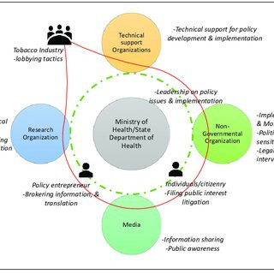
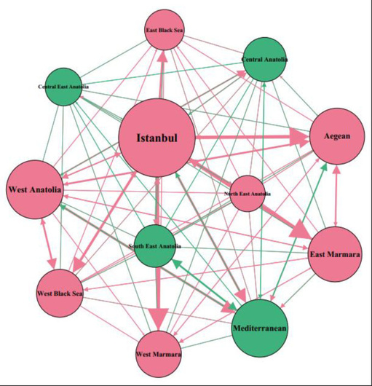
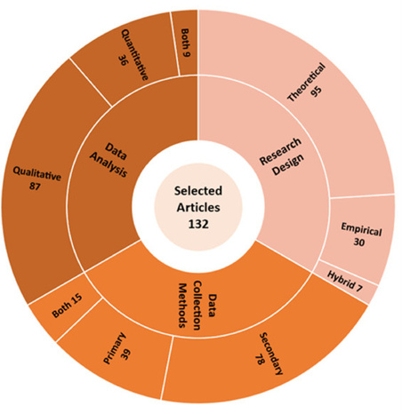
INFOGRAPHICS

Slide 16
CONCLUSION
Summary:
SNA effectively identifies governance efficiencies, public discourse trends, and security threats.
Weaknesses:
Static snapshots (e.g., terrorist networks need real-time updates).
Bias in open-source data (media reports, Twitter samples).
Future Directions:
Integrate machine learning for dynamic SNA (e.g., live Twitter monitoring).
Expand multisectoral network mapping to other health policies.

Slide 17
REFERENCE
Link: https://gh.bmj.com/content/7/1/e006471
﻿Brief Description:Mondal, S., et al. (2022). BMJ Global Health.
Link:https://www.mdpi.com/1660-4601/17/21/8235
﻿Brief Description:Ahmed, W., et al. (2020). IJERPH.
Link:https://www.researchgate.net/profile/Aparna-Basu/publication/228962297_Social_network_analysis_of_terrorist_organizations_in_India/links/550b22490cf265693cef69b7/Social-network-analysis-of-terrorist-organizations-in-India.pdf. Brief Description: Basu, A. (2005). ResearchGate

Slide 18
Thank You

